Slide 1

Food delivery application in swiggy.
N.BALAJI
192011168
CSA3731
SOFTWARE TESTING FOR ANDRIOD APPLICATION
DATE: 31/01/2023

Slide 2

OBJECTIVE
The purpose of an online ordering system is to make itself beneficial for the customer
the business that they can stay afloat while also serving customers their favorite dishes

Slide 3

ABSTRACT
Online food ordering and delivery is a new type of business model in the current era of e-commerce and that leads to the startups of several online business.
Online food ordering and delivery is very successful because it bridges the gap between restaurants and consumers.
It is a process were a customer will search for a restaurant and filter with the available items and they deliver by an application in the mobile phone.
Swiggy is an application for food ordering and delivery which is a Bangalore based company.
Swiggy was mainly to provide a complete order and delivery solution to the urban foodies.

Slide 4

PROPOSAL WORK
Validation that the restaurant name is searchable in the search text box.
Validation that the cuisine name is searchable in the search text box.
Validation that the dish name is searchable in the search text box.
Verify users can customize the order for the customizable items.
Verify green and red dots are marked against items as per veg and non-veg.
Verify rating of food items should be displayed clearly.
Verify images should be correctly shown against the item.

Slide 5
Flow chart
.
Order Request system, Confirm the Receipt of Order
start
Customer place order
Confirm the
order
Normal order
Dispatch the
order
Special order
end
end

Slide 6
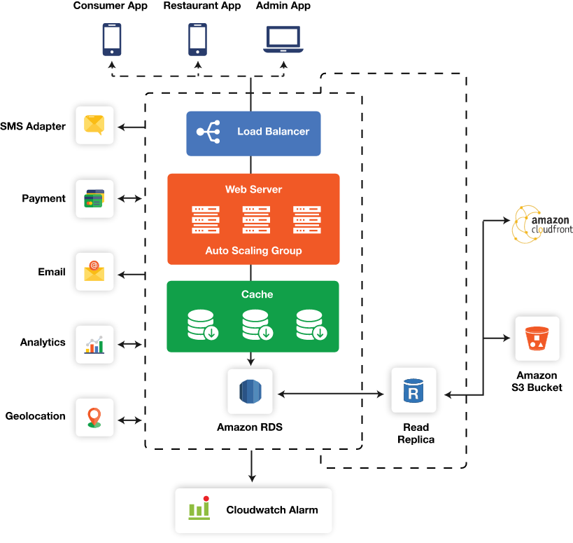
Concept map
APPIUM

Slide 7



APPS TOOLS AND INSTALLATION
ANDROID STUDIO
APPIUM INSPECTOR
APPIUM SERVER

Slide 8
APP TOOLS AND INSTALLATION
Appium is an open source automation tool
We can call it an open source automation framework
It allows us to automate the different type of mobile applications
It could be a web application ,it could be a native or hybrid application
It works on emulator as well as real device’s

Slide 9
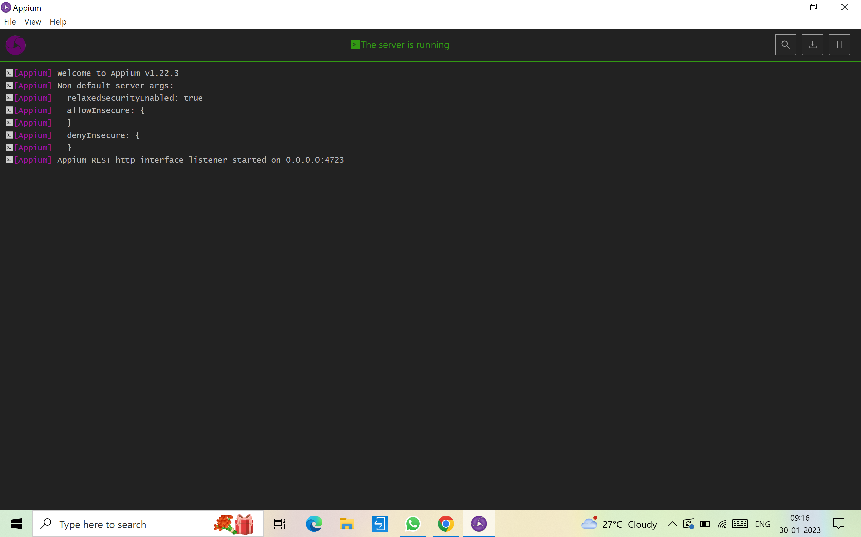
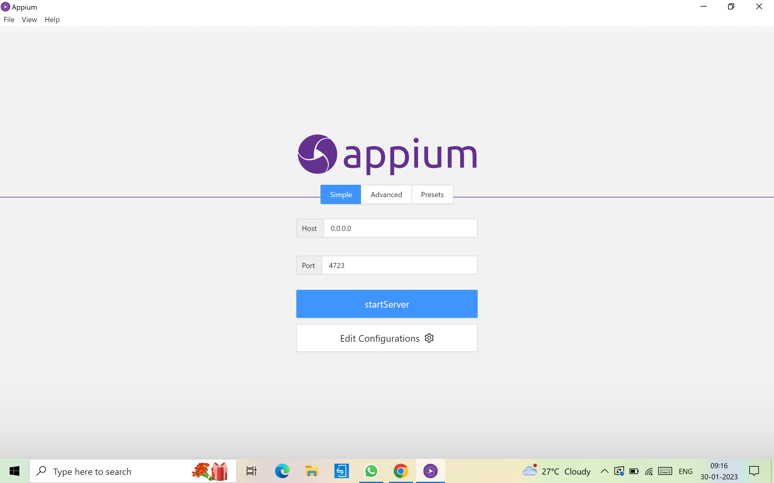
IMPLEMENTATION

Slide 10
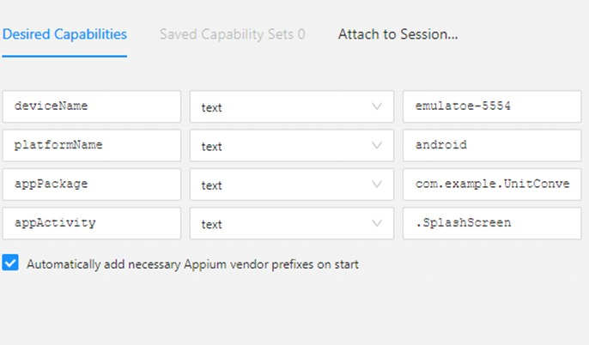
APPIUM INSPECTOR
Give the Desired Capabilities in Appium Inspector.
It will start the session and gives you java code to start testing.
Paste the code in IntelliJ IDE and Start the Testing.

Slide 11
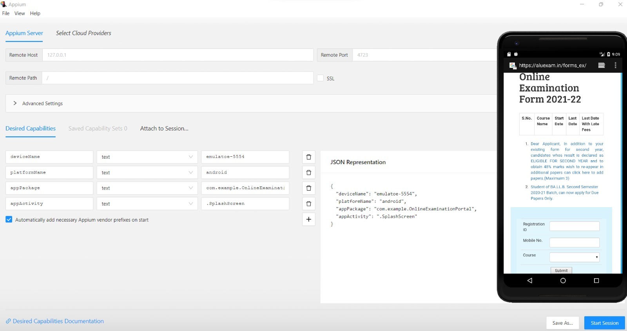
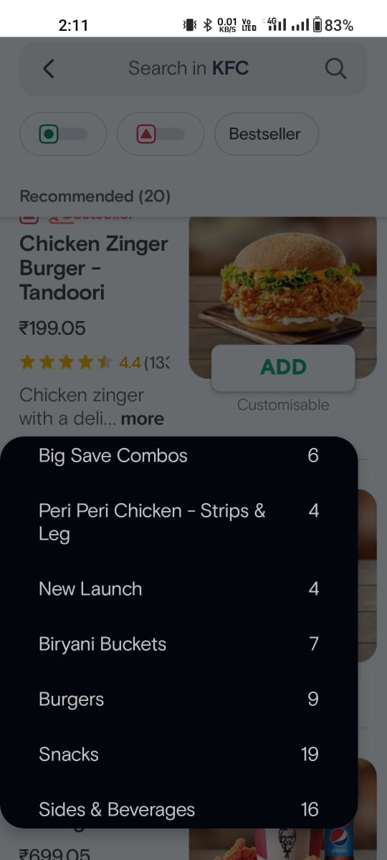
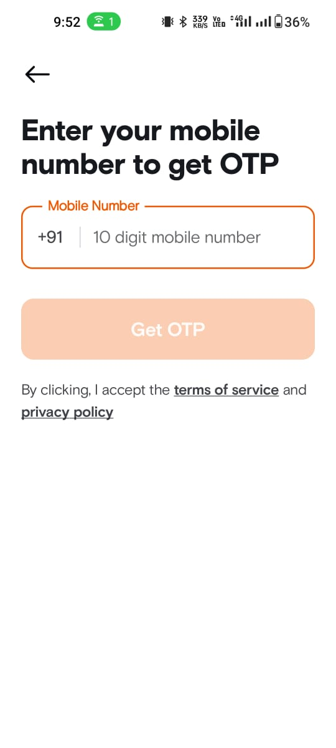
Appium inspector

Slide 12
TEST CASE
TEST CASE | PASS\FAIL
Verification that delivery location should be shown on the cart page. | PASS
2. Verify right items are displayed on the cart page. | PASS
3. Verify about, send feedback, log out options should be displayed correctly. | PASS
4. Verify users can create an account username and email. | PASS
5. Verify users can log in to a Zomato account using a mobile number. | PASS
6 Check if payment failed then user can access the swiggy | FAIL
7. check if anauthorized user can access the record and change payment | FAIL
8. check if the copy of bill is generated and saved in history can delete | FAIL
9. Check if the doctor is added but the payment is pending user can access or not before payment | FAIL
10. check if the bill and payments are done without authentication | FAIL

Slide 13
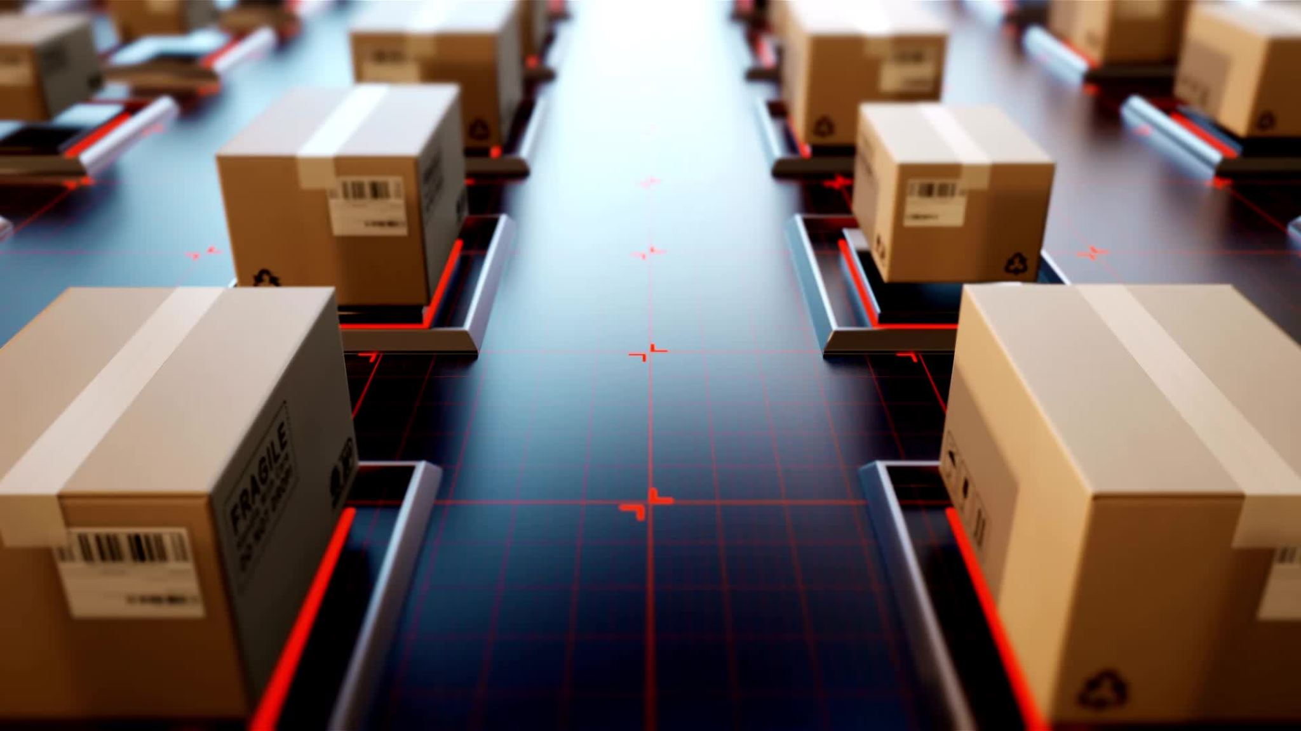
conclusion
Swiggy understood the customers on both sides of their platform and curbed multihoming to build an impressive platform in a competitive space

